Slide 1

CyberEPQ presentation
How effective are passwords as a means of authentication?
Lucian James
FBO9891

Slide 2
Introduction
What was my project about? Passwords!
Passwords are used everywhere for authentication, but how is the security of these password-based systems ensured?
My project investigated how password authentication systems are built and how they could potentially be exploited, as well as how these exploitable vulnerabilities could be mitigated

Slide 3

Research
Me doing research
I conducted my research primarily through scholar.google.com.
I tried to select articles with a greater number of citations than others.
I mostly researched as I wrote my essay
My research consisted entirely of reading papers, I did not do any interviews or surveys.

Slide 4
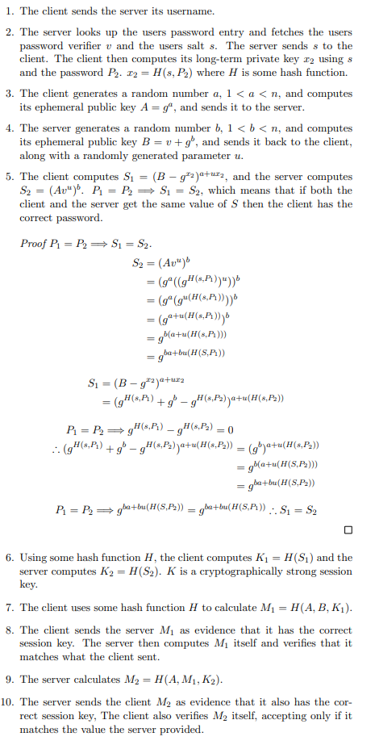
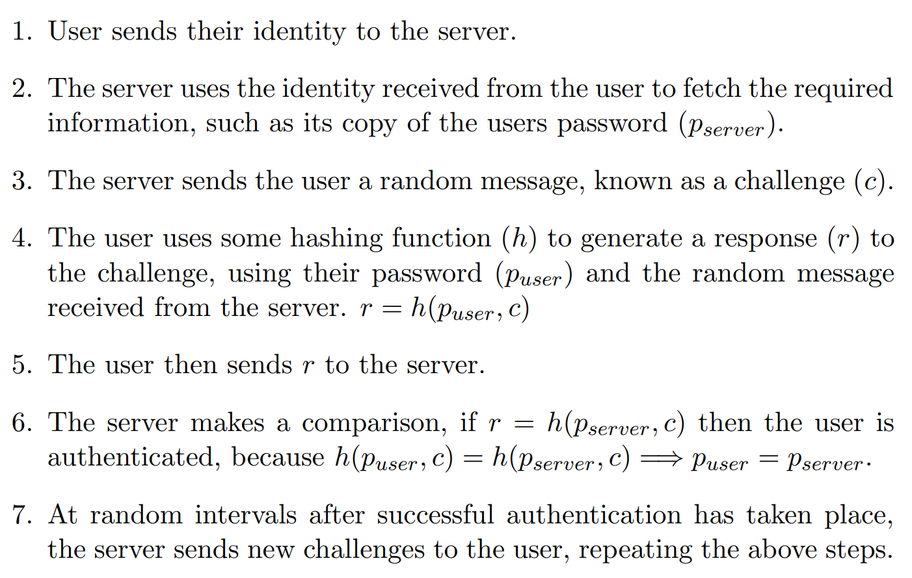
Password protocols
I spent a significant amount of time researching some protocols which can be used for password authentication.
These protocols ranged from no security (PAP) to much higher security (SRP, OPAQUE)
SRP
CHAP

Slide 5
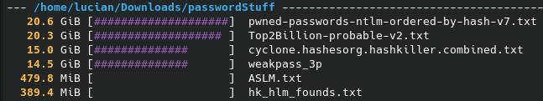
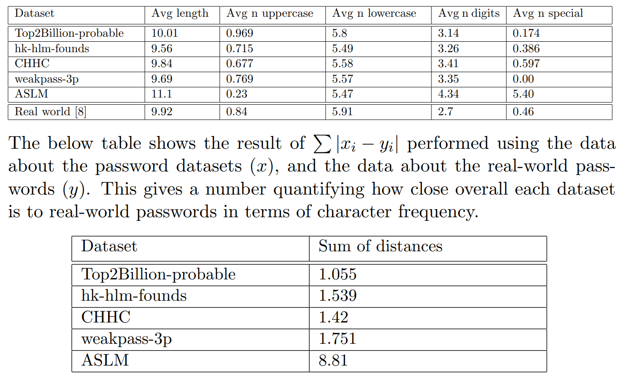

Password dataset analysis
I collected over 70 gigabytes worth of files for this project.
The majority of which was password “dictionaries”, and 20GB of hashes from haveibeenpwned.com
I analysed the password dictionaries I had by doing a character-level comparison with real world data sourced from other work

Slide 6
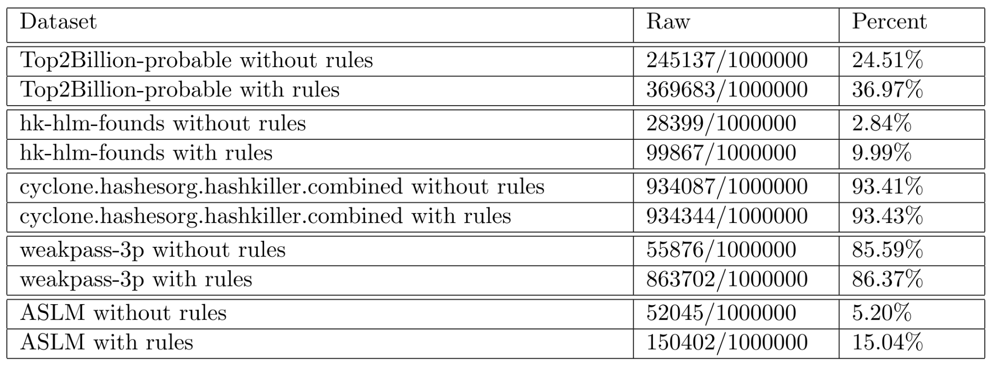
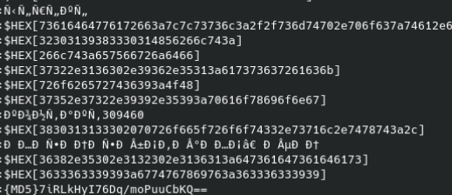
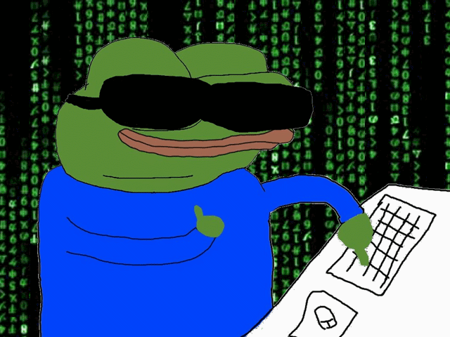
Password cracking analysis
Using my collection of “passwords” and a “rules” list, I utilised hashcat to perform decryption of some of the hashes from haveibeenpwned.
The goal of this analysis was to estimate what proportion of hashed passwords could be cracked this way.
“Rules” modify every password in the input dictionary in slight ways, to increase the total amount of different passwords. Top2Bil + my rules = 451,867,115,734 total passwords
My analysis unfortunately did not produce good quality results, due to low quality data from haveibeenpwned.

Slide 7

Vulnerabilities + mitigations
I sourced information about a few different vulnerabilities password-based authentication systems may have.
I then sourced potential mitigations for these vulnerabilities.
I found lots of good information about preventing phishing
Vulnerabilities:
Weak passwords + insecure behaviour
Phishing
SQL injection
Man-In-The-Middle
ur data

Slide 8
Conclusion
Throughout this entire project, it became clearer and clearer that:
Systems can be secured very well, very easily.
Getting users to behave securely is not.
It is certain that users are often the weakest part of a system which utilises passwords for authentication.
While my password cracking analysis had some flaws, it does still indicate that a large (25-35%) amount of passwords may be able to be cracked using dictionary attacks.

Slide 9

Evaluation
My project had some interruptions which affected how strictly timescales were followed, and the practical aspect had its flaws.
Despite this, I think I have produced a good quality essay on an interesting subject.
I may continue some of the parts of my project, such as the password cracking analysis, which I would like to see done successfully.

Slide 10

Questions

